Slide 1

Predicting Startup Success Using Investment and Growth Data

Slide 2




Project Overview
Analyze Success Factors
Identify key variables influencing startup performance using real-world data
Apply Machine Learning
Develop models to predict growth rate with statistical validity
Generate Insights
Provide actionable recommendations for investors and founders

Slide 3








Objectives
Build Predictive Models
Analyze Funding Patterns
Create algorithms to forecast growth rates
Examine investment trends across industries
Identify Key Factors
Offer Recommendations
Determine critical variables behind startup growth trajectories
Provide data-driven investment strategies

Slide 4





Dataset Description
Source & Size
Kaggle dataset containing 5,000 startup entries with no missing values
Key Features
Industry, Funding Rounds, Investment & Valuation, Number of Investors
Geographic Scope
Multiple countries including USA and Germany with founding year data
Target Variable
Growth Rate (%) - primary metric for success prediction

Slide 5

Exploratory Data Analysis
Growth Rate Insights
Average growth rate across all startups: 102.1%
Significant variation observed between industries
Industry Leaders
EdTech and Fintech sectors demonstrate highest growth rates
Technology-driven sectors outperform traditional industries
Geographic Patterns
Germany and USA show highest growth percentages
Developed markets provide stronger growth environments
Key Correlations
Strong positive relationship between Investment and Valuation
Initial findings suggest funding influences company value

Slide 6
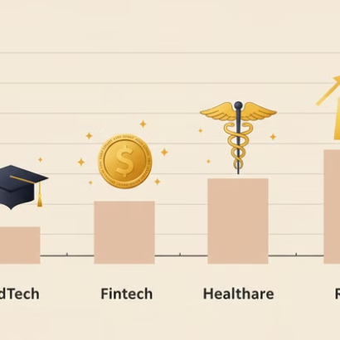
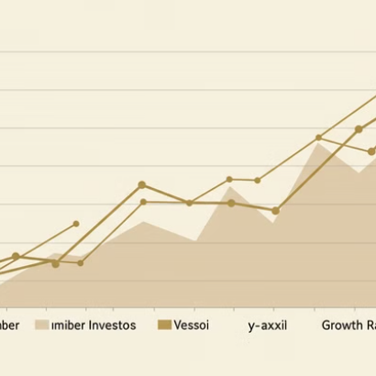
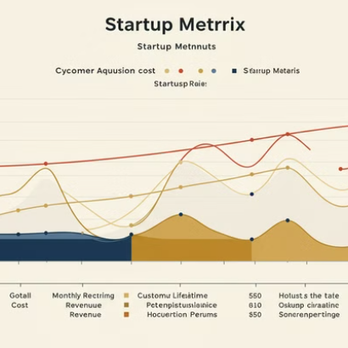
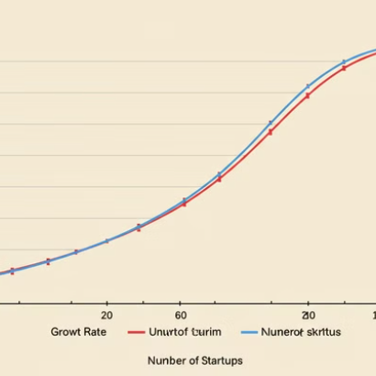
Visual Insights
Visual analysis reveals patterns in growth distribution and correlation strength between key variables.

Slide 7

Feature Engineering
Categorical Encoding
Transformed Industry and Country variables into numerical features
One-hot encoding for nominal variables
Label encoding for ordinal variables
New Feature Creation
Developed composite indicators to enhance predictive power
Funding-to-Investment Ratio
Normalized Investor Count
Time Since Founding (years)
Target Transformation
Applied logarithmic transformation to Growth Rate variable
Normalized distribution
Reduced impact of outliers

Slide 8






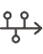



Modeling Approach
Tree-Based Models
Linear Models
Decision Tree, Random Forest
Linear, Ridge, Lasso, ElasticNet Regression
Boosting Methods
Gradient Boosting, AdaBoost
Evaluation Metrics
R², MSE, MAE
Complex Models
Support Vector Machine

Slide 9
Model Tuning
Hyperparameter Optimization
Model Performance
Applied GridSearchCV to systematically test parameter combinations.
Best Model
Gradient Boosting
Explored learning rate, tree depth, and regularization strength.
R² Score
0.0004
MSE
0.5939
Cross-validation prevented overfitting during parameter selection.
MAE
0.6259
Model saved as .pkl for deployment and future predictions.

Slide 10








Key Findings
EdTech Leadership
Educational technology sector shows highest average growth
Investment-Valuation Link
Strong correlation between funding amount and company valuation
Investor Count Impact
Number of investors has minimal influence on growth rate
Complex Success Factors
Existing features alone don't strongly explain growth variation

Slide 11





Business Recommendations
Diversify Products
Expand Markets
Strategic Acquisitions
Expand offerings to capture wider customer base and increase revenue streams.
Enter new geographic regions and market segments for growth opportunities.
Acquire complementary businesses to enhance capabilities and market position.
Data Dashboard
Implement Tableau dashboards for real-time investor decision support.

Slide 12


Conclusion
Directional Value
1
Machine learning provides valuable directional insights for startup evaluation
Key Indicators
Industry and geography emerge as strongest predictive factors
Future Work
Incorporate qualitative data and granular investment timelines
This research contributes a data-driven framework for startup evaluation. It highlights both the potential and limitations of predictive modeling in this domain.

